Slide 1

Jawahir Ali UML Diagram Of Class Inheritance
Objected Oriented Programming

Slide 2
Object Oriented Programming-UML Diagrams
UML Diagrams:
Inheritance and its types
Single Inheritance
Multiple inheritance
Multilevel Inheritance
Hierarchical Inheritance

Slide 3
Why we use UML Diagram?
Symbol | Meaning
- | The attribute or operation is private.
+ | The attribute or operation is public.
UML class diagram to show a static view of a system's classes, their attributes and methods, and the relationships among objects.

Slide 4
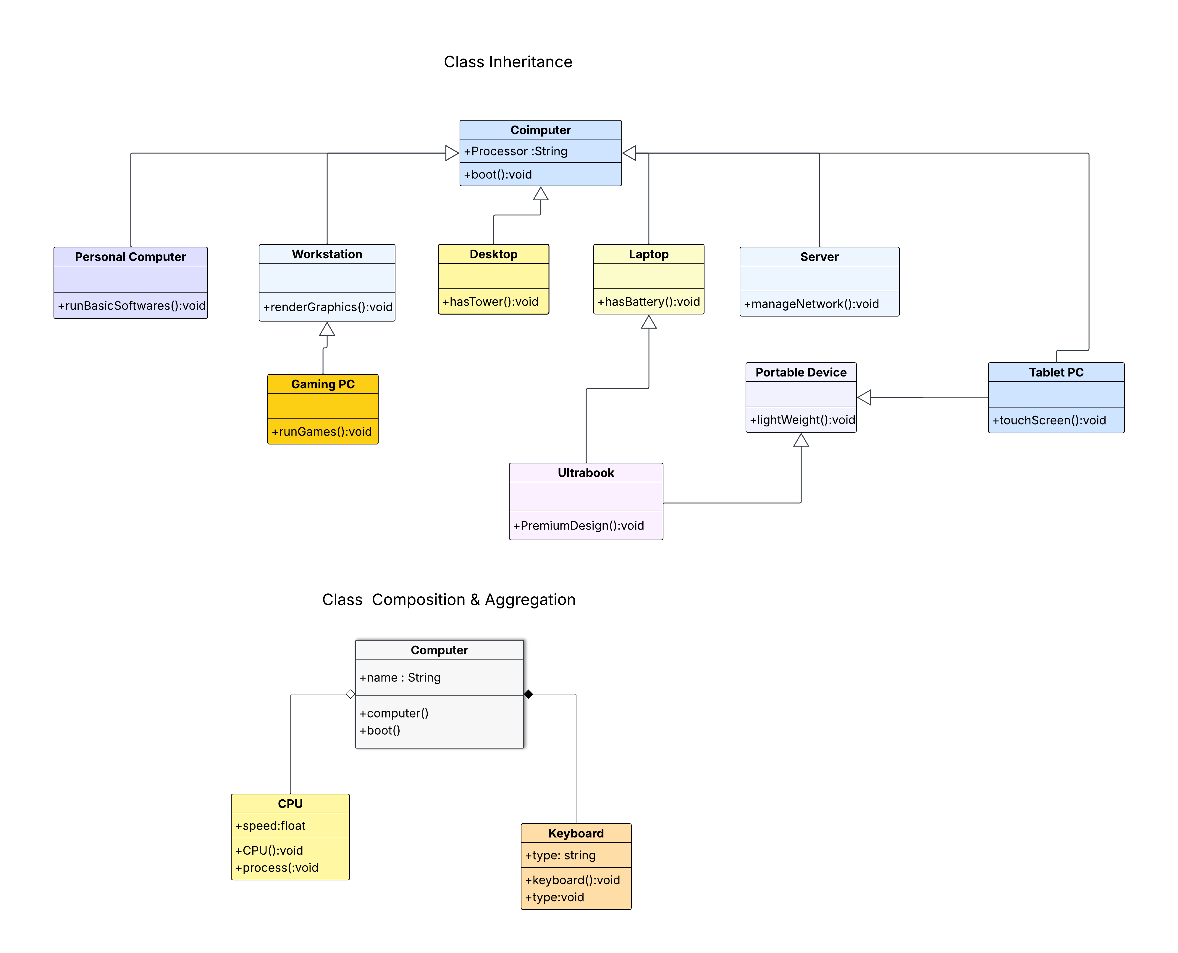

Slide 5
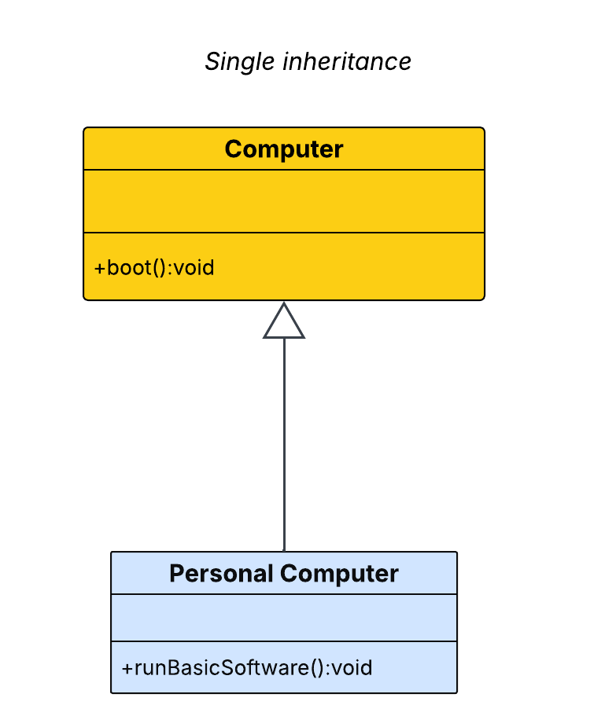
Single Inheritance
PersonalComputer ← Computer: In this class computer is Parent or base class while Personal Computer is Child or Derived Class.
A class inherits from one base class.

Slide 6
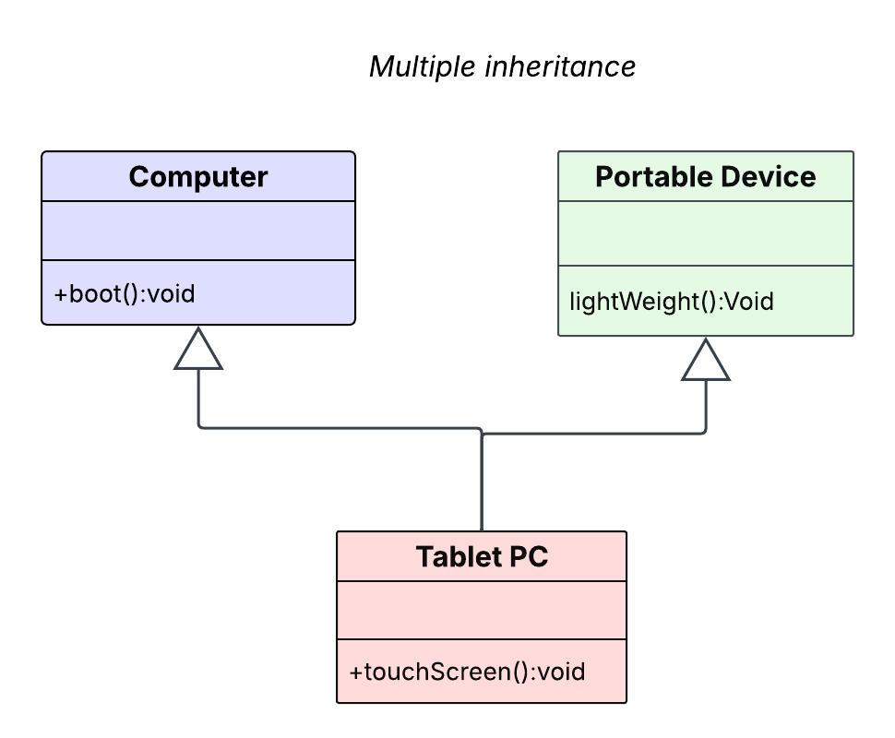
Multiple Inheritance
Tablet ← Computer Tablet ← Portable Grandchild - Child Class - Parent Class
A class inherits from a derived class (chain)

Slide 7
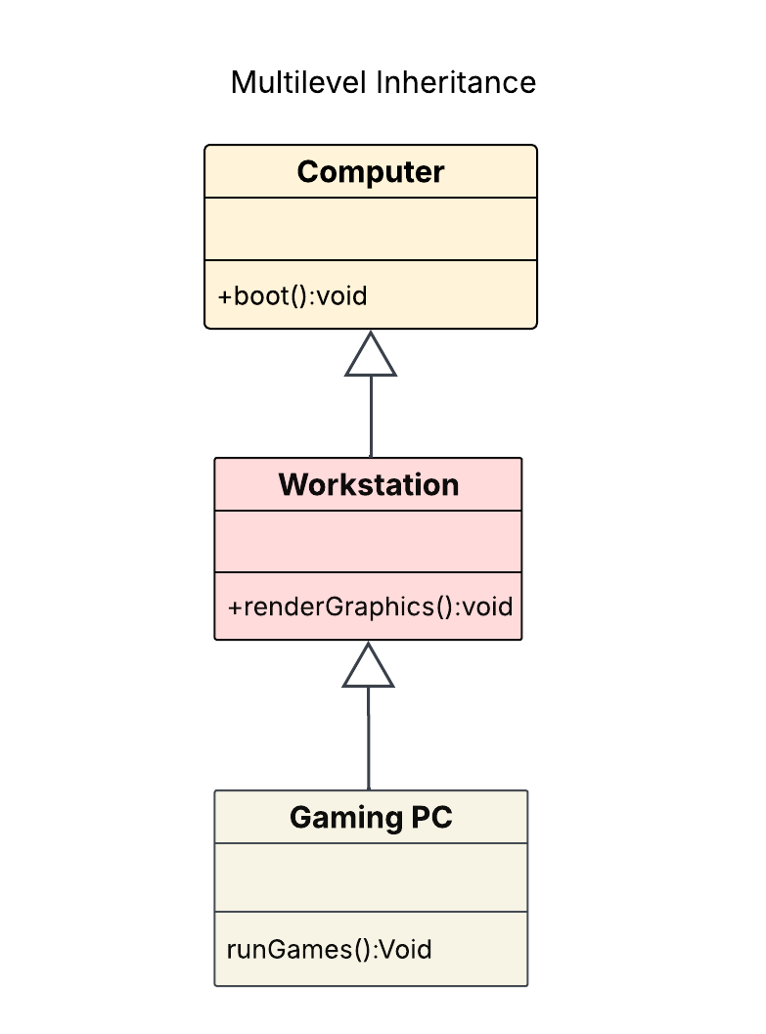
Multilevel Inheritance
Computer → Workstation → GamingPC
A child class inherits from a parent, and another class inherits from that child (chain of inheritance).

Slide 8
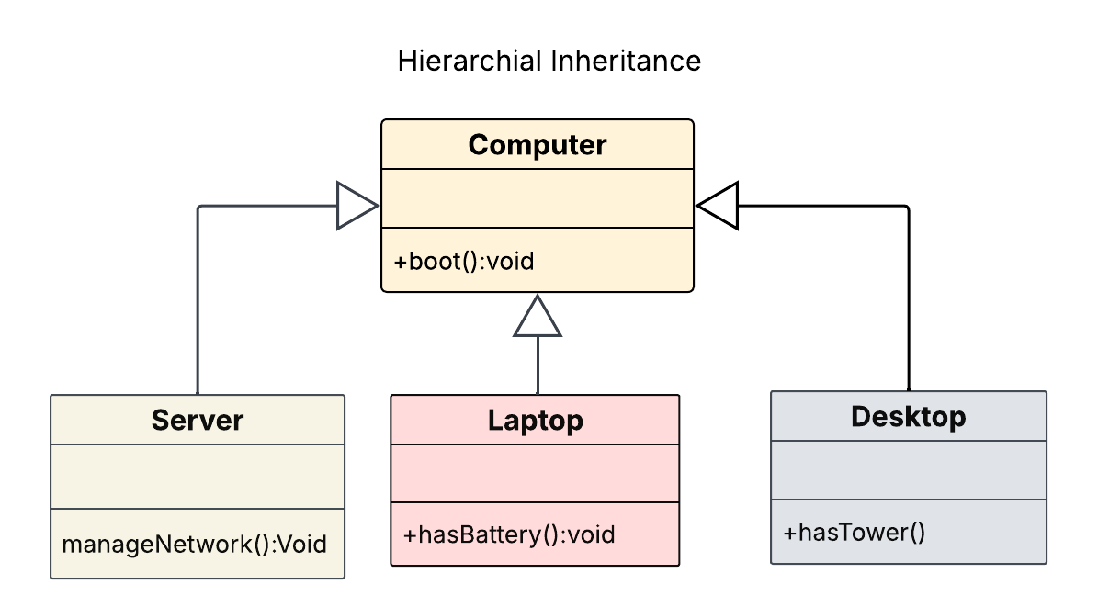
Hierarchical Inheritance
Desktop, Laptop, Server ← Computer
Multiple classes inherit from one base class

Slide 9
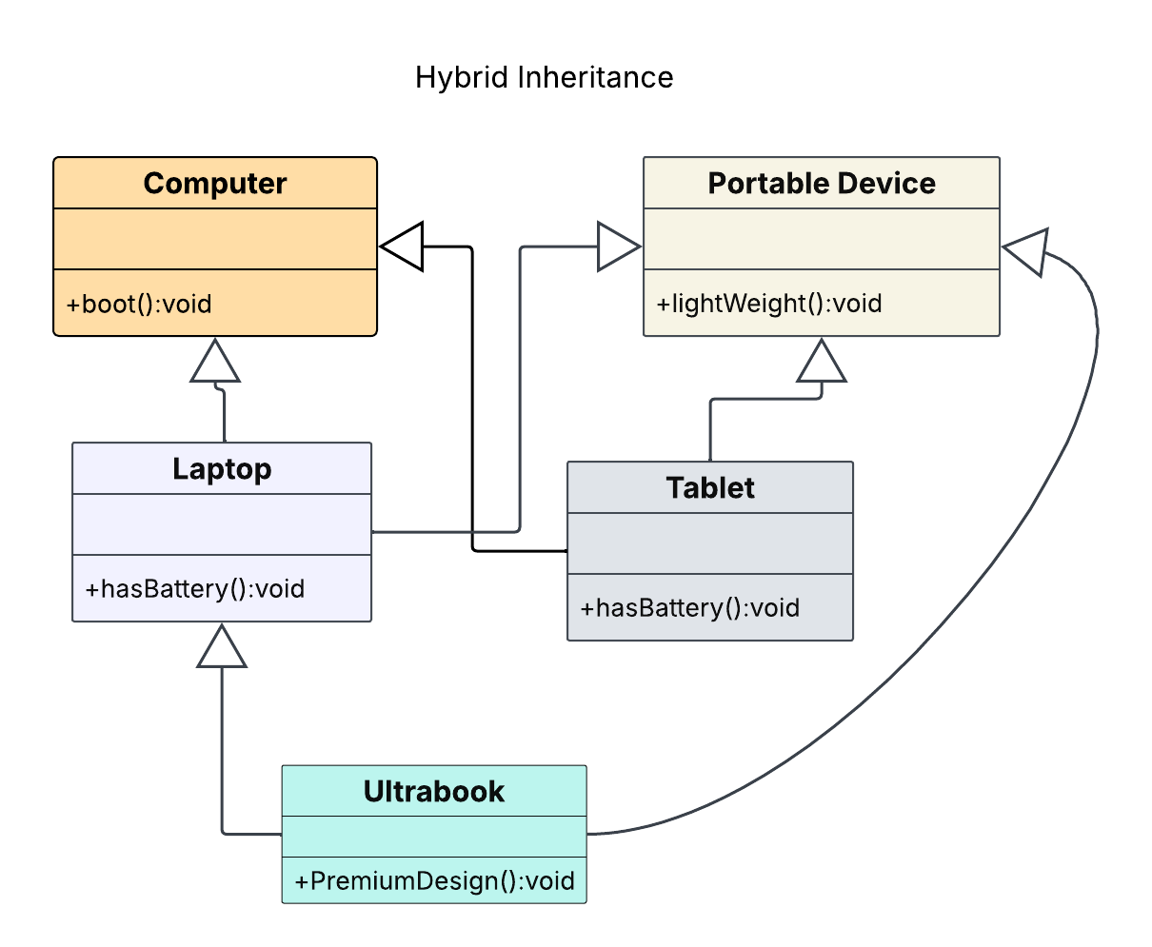
Hybrid Inheritance
Ultrabook ← Laptop + PortableDevice Tablet←computer+laptop
Laptop←computer+potable device

Slide 10
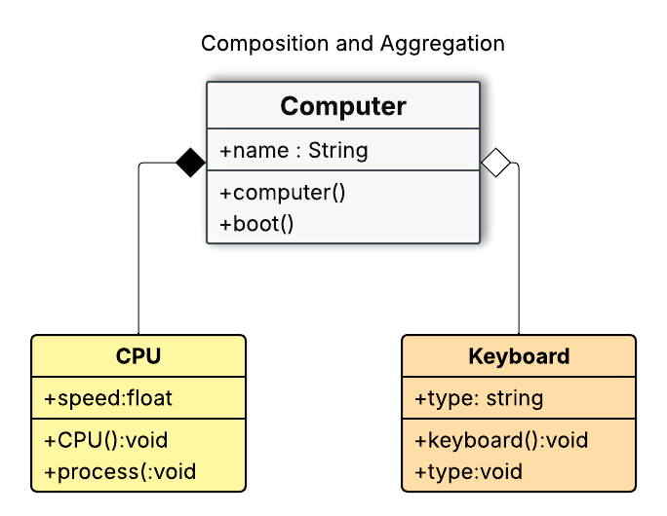
Composition & Aggregation

Slide 11
Difference b/w Composition & Aggregation
Composition
Strong relationship exist b/w parent and child class can’t exist independently.
Filed Diamond ( ) to show relation.
Deleting parent class---Delete child class.
Computer ------- CPU.
Aggregation
Weak relationship b/w parent and child class independently exist.
Unfilled or Hollow diamond ( ) used to show relation.
Deleting parent class does not delete child class.
Computer ----Keyboard.

Slide 12

Questions & Answers

